Slide 1
Ingredients in Cosmetic Products

Slide 2
agenda
Introduction
Methodology
Questions
Results
Future Work
Appendix

Slide 3
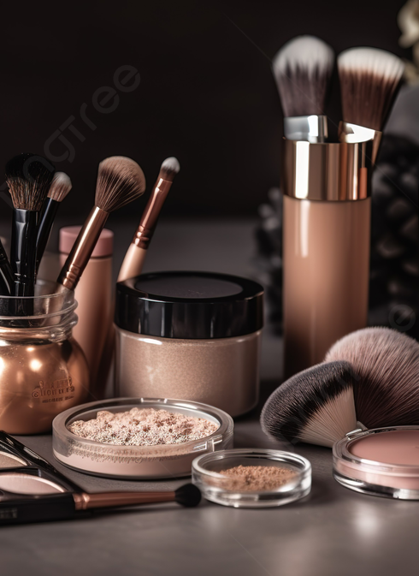
Introduction What is in the cosmetics we use? Who benefits from this analysis? ~day_to_day user ~sustainable businesses ~healthcare

Slide 4
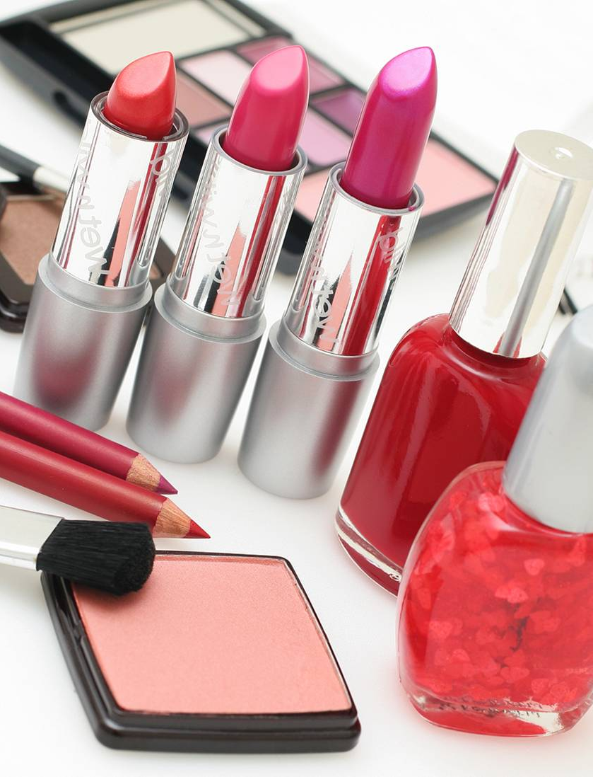
Methodology Chemicals in Cosmetics - Dataset - California Health and Human Services Open Data Portal ~csv file ~Jupyter notebooks, Excel, ChatGPT and textbook

Slide 5
Questions
What are the 5 most common chemicals in the beauty products?
What is the distribution for the primary category (class?
Which product category (class) contain the 5 most common chemicals?
What is the distribution of the top 5 chemicals in the top 10 brands (by count)?

Slide 6
What are the 5 most common chemicals in the beauty products?
Titanium dioxide
Silica, crystalline
Retinol/retinyl esters
Mica
Butylated hydroxyanisole

Slide 7
What is the distribution for the primary category (class?
66% of all the products are non- permanent makeup products and 13% are in the nail products class
That makes 79% of all the products in the dataset

Slide 8
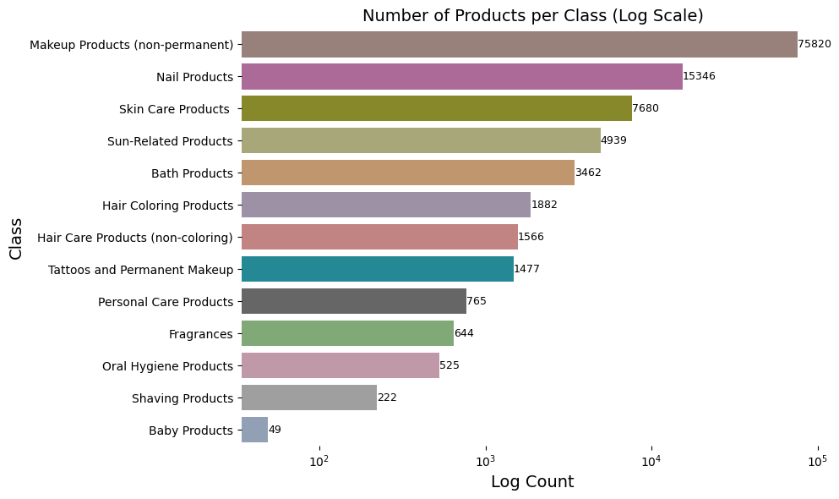

Slide 9

Which product category (class) contain the 5 most common chemicals?
9/13 classes contain all five chemicals
The relative frequencies show that titanium is widely used in all the product classes.
Retinol/retinyl esters is found in a significant proportion of the products particularly in Personal Care Products, Shaving Products, Skin Care Products and baby products.

Slide 10
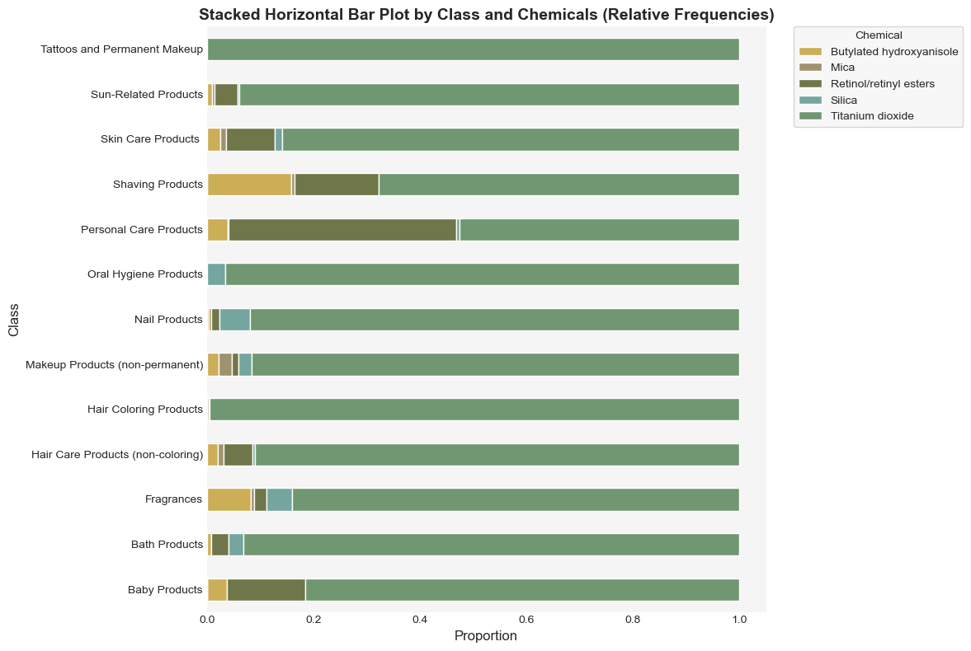

Slide 11
What is the distribution of the top 5 chemicals in the top 10 brands (by count)?
All brands have 1300+ products containing titanium dioxide
1014 Charlotte Tilbury products contain silica
NARS, NYX and Sally Hansen have Butylated hydroxyanisole
There are 544 Sephora products with Mica
329 Victoria's Secret Beauty products have Retinol/retinyl esters

Slide 12
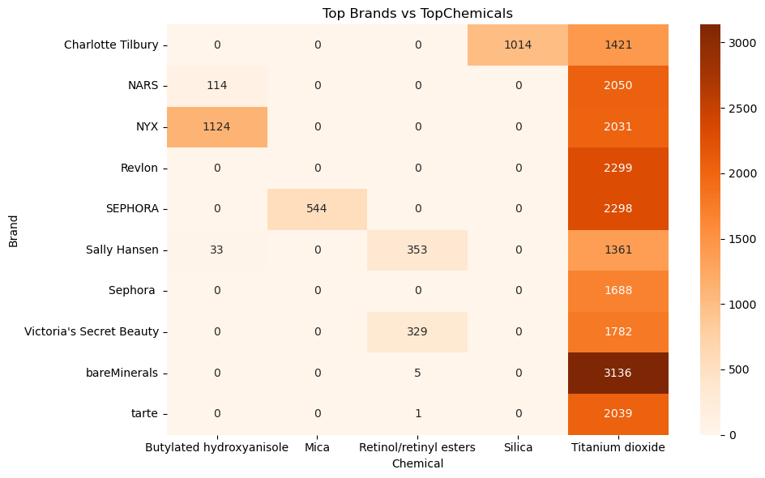

Slide 13
Future Work
Research on the rankings of the chemicals in terms of toxicity
Look into bans in other states or countries
Research on similar data sets to find more insights

Slide 14
Recommendations
Look into the products you use
Avoid products with any hazardous ingredients

Slide 15
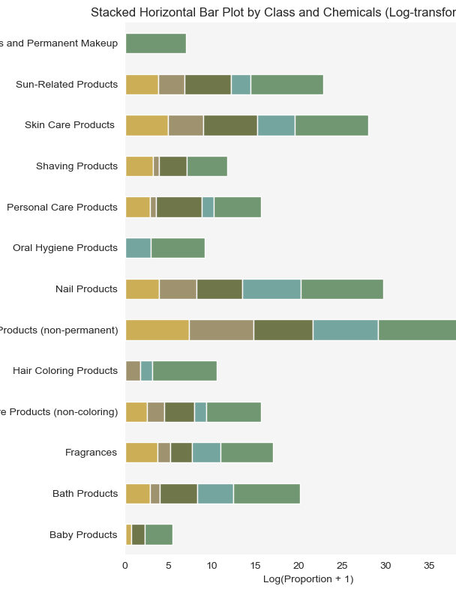
Appendix

Slide 16
Thank You

